Slide 1
Introduction to Big Data

Slide 2




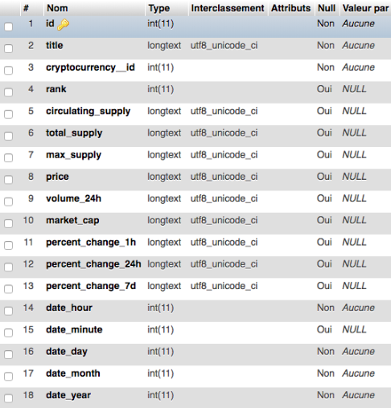
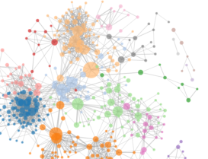
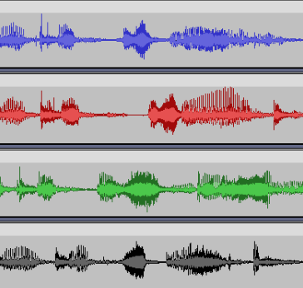


The “V’s” of Big Data
The ultimate goal of working with big data
The physical storage size of data, may reach the levels of terabytes or petabytes
Value
Refers to the sources and formats of data, big data can come from any sources in any forms
Volume
The speed that data is generated, collected, processed, and analyzed. Big data velocities typically are in days to real-time
Variety
The reliability of data. Big data should result in trustable and reliable knowledge
Velocity
Veracity

Slide 3
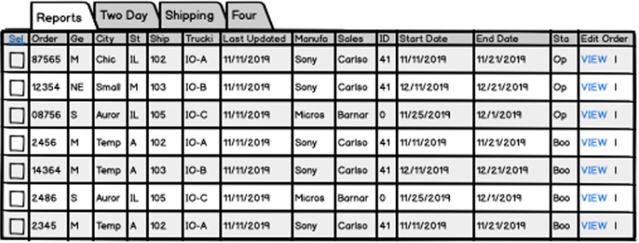
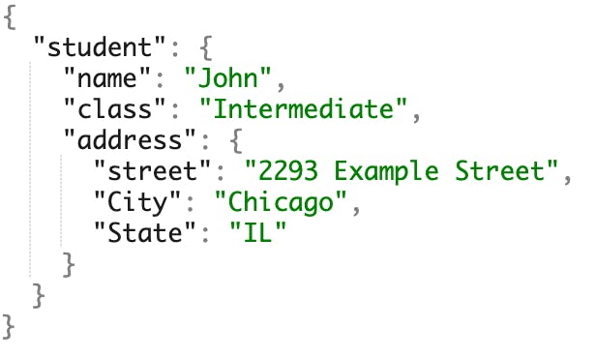

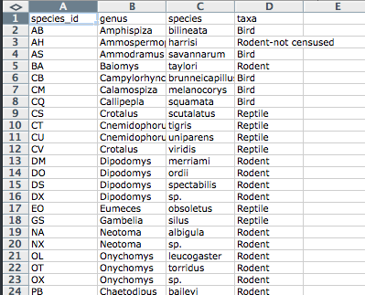
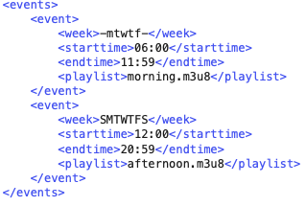

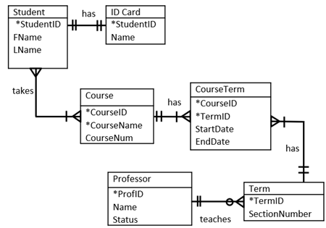
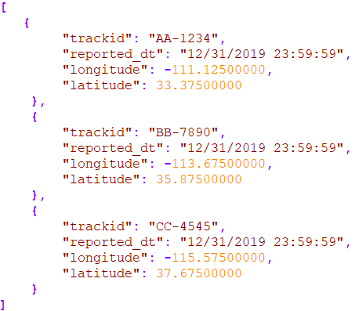
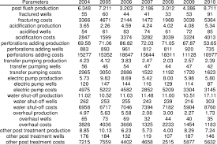
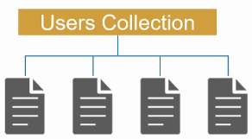
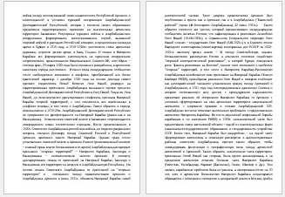

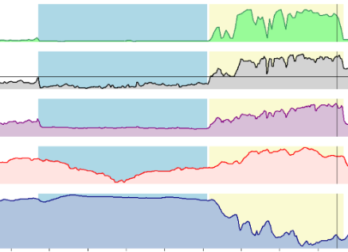
Types of Big Data
Structured data
Stored and organized as relational tables
Semi-structured data
Typically are similar to JSON and XML
Unstructured data
Raw and has varied format. These can be text, images, videos, audios, signals, etc

Slide 4
Big Data Applications
Product development. Usage data on current products and customers can be used to design and develop new ones
Predictive maintenance. Analyze data of machinery systems to determine whether they are operating properly or if maintenance might be needed
Fraud and compliance. Determine anomalies in data that indicate frauds
Machine learning. Big data enable the booming of machine learning technologies – more complex technologies require learning from bigger data
And many more…

Slide 5
Challenges in Big Data
Storage. As data grows, so do the requirement for their storages. This also relates to aspects like redundancy, retrieval, etc.
Processing. Bigger data may come with more issues like missing or incorrect fields. The process of cleaning data therefore is more difficult. Cleaning and modeling big data are also more computationally expensive
Rapid evolvement. Both data and the technologies used to handle them evolves extremely fast. Keeping up with the current technologies, while challenging, is critical

Slide 6
This course
Focuses on the administration of big data using
Hadoop/YARN/Spark
NoSQL databases
Cassandra
MongoDB
And a bit of data analytics with Hadoop/Spark

Slide 7
Extra Reading
https://www.mongodb.com/basics/big-data-explained
https://www.oracle.com/big-data/what-is-big-data/#challenges
https://aws.amazon.com/big-data/what-is-big-data/
https://www.gcu.edu/blog/engineering-technology/what-are-4-vs-big-data
https://www.tutorialspoint.com/hadoop/hadoop_big_data_overview.htm

